Slide 1
Chapter Four
Software Development Methodologies and Paradigms

Slide 2
Contents
Software Engineering Practice
Essence of Practice
Core Principles of Software Engineering
Types of Practice
Software Engineering Methodologies
Software Development Paradigm

Slide 3
Recall
Software engineering (SE) is concerned with developing and maintaining software systems that behave reliably and efficiently, are affordable to develop and maintain, and satisfy all the requirements that customers have defined for them.
Development requires analysis and synthesis
Analysis: decompose a large problem into smaller, understandable pieces
Synthesis: build (compose) software from smaller building blocks

Slide 4
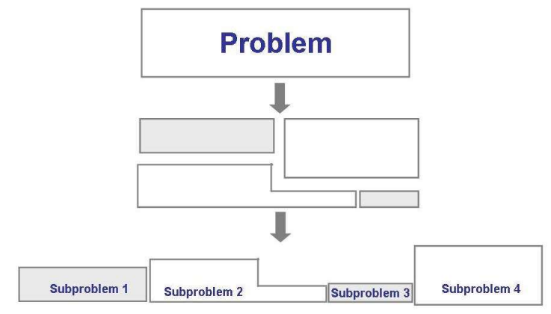
Software Engineering: Solving Problem
The analysis process

Slide 5
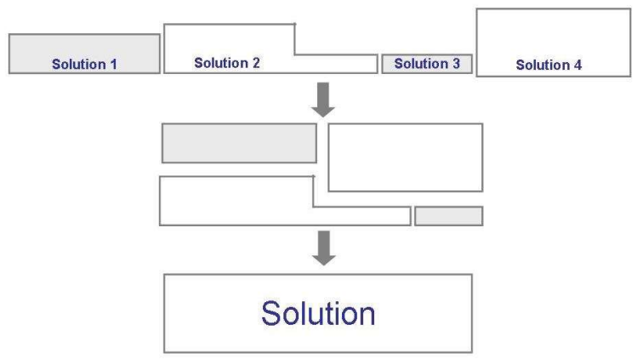
The synthesis process

Slide 6
Software Engineering Practice
Consists of a collection of concepts, principles, methods, and tools that a software engineer calls upon on a daily basis
Equips managers to manage software projects and software engineers to build computer programs
Provides necessary technical and management knowledge how to getting the job done

Slide 7
Essence of Practice
1. Understand the problem (communication and analysis)
Who has a stake in the solution to the problem?
What are the unknowns? and what (data, function, behavior) are required to properly solve the Problem?
Is it possible to represent smaller problems that may be easier to understand.
Can the problem be represented graphically? Can analysis model be created?

Slide 8
Cont’d
2. Plan a solution (planning, modeling and software design)
Have you seen similar problems like this before?
Has a similar problem been solved? If so, are the elements of the solution reusable?
Can sub problems be defined and are solutions available for the sub problems?

Slide 9
Cont’d
3. Carry out the plan (construction; code generation)
Does the solution conform to the plan? Is the source code traceable back to the design?
Is each component of the solution correct? Has the design and code been reviewed, or better?

Slide 10
Cont’d
4. Examine the results for accuracy (testing and quality assurance)
Is it possible to test each component of the solution? Has a reasonable testing strategy been implemented?
Does the solution produce results that conform to the data, function, and behavior that are required?
Has the Software been validated against all stakeholders requirement?

Slide 11
Core Principles of Software Engineering
1. Remember the reason that the software exists
The software should provide value to its users and satisfy the requirements
2. Keep it simple
All design and implementation should be as simple as possible
3. Maintain the vision of the project
A clear vision is essential to the project’s success
4. Others will consume what you produce
Always specify, design, and implement knowing that someone else will later have to understand and modify what you did

Slide 12
Cont’d
5. Be open to the future
Never design yourself into a corner; build software that can be easily changed and adapted.
6. Plan ahead for software reuse
Reuse of software reduces the long-term cost and increases the value of the program and the reusable components.
7. Think, then act
Placing clear, complete thought before action will almost always produce better results

Slide 13
Types of Practices
Communication Practice
Planning Practice
Modeling Practice
Construction Practice
Testing Practice
Deployment Practice

Slide 14
Communication Practice
Listen to the speaker and concentrate on what is being said
Prepare before you meet by researching and understanding the problem
Someone should facilitate the meeting and have an agenda
Face-to-face communication is best, but also have a document or presentation to focus the discussion
Take notes and document decisions

Slide 15
Cont’d
6. Strive for collaboration and consensus
7. Stay focused on a topic; modularize your discussion
8. If something is unclear, draw a picture
9. Move on to the next topic
a) after you agree to something,
b) if you cannot agree to something, or
c) if a feature or function is unclear and cannot be clarified at the moment
10. Negotiation is not a contest or a game; it works best when both parties win

Slide 16
Planning Practice
1. Understand the scope of the project
2. Involve the customer in the planning activity
3. Recognize that planning is iterative; things will change
4. Estimate based on only what you know
5. Consider risk as you define the plan

Slide 17
Cont’d
6. Be realistic on how much can be done each day by each person and how well
7. Adjust granularity as you define the plan
8. Define how you intend to ensure quality
9. Describe how you intend to accommodate change
10.Track the plan frequently and make adjustments as required

Slide 18
Modeling Practice (Analysis)
The information domain of a problem (the data that flows in and out of a system) must be represented and understood
The functions that the software performs must be defined
The behavior of the software (as a consequence of external events) must be represented
The models that depict information, function, and behavior must be partitioned in a manner that uncovers detail in a layered (or hierarchical) fashion
The analysis task should move from essential information toward implementation detail

Slide 19
Modeling Practice (Design)
1. The design should be traceable to the analysis model
2. Always consider the software architecture of the system to be built
3. Design of data is as important as design of processing functions
4. Interfaces (both internal and external) must be designed with care
5. User interface design should be tuned to the needs of the end-user and should stress ease of use

Slide 20
Cont’d
6. Component-level design should be functionally independent (high cohesion)
7. Components should be loosely coupled to one another and to the external environment
8. Design representations (models) should be easily understandable
9. The design should be developed iteratively; with each iteration, the designer should strive for greater simplicity

Slide 21
Construction Practices (Before Coding)
Understand the problem you are trying to solve
Understand basic design principles and concepts
Pick a programming language that meets the needs of the software to be built and the environment in which it will operate
Select a programming environment that provides tools that will make your work easier
Create a set of unit tests that will be applied once the component you code is completed

Slide 22
Construction Practices (When Coding Begin)
Constrain your algorithms by following structured programming practices
Select data structures that will meet the needs of the design
Understand the software architecture and create interfaces that are consistent with it
Keep conditional logic as simple as possible
Create nested loops in a way that makes them easily testable
Select meaningful variable names and follow other local coding standards
Write code that is self-documenting
Create a visual layout (e.g., indentation and blank lines) that aids code understanding

Slide 23
Construction Practices (When Coding End)
Conduct a code walkthrough
Perform unit tests (black-box and white-box) and correct errors you have uncovered
Refactor the code

Slide 24
Testing Practice
All tests should be traceable to the software requirements
Tests should be planned long before testing begins
The Pareto principle applies to software testing
80% of the uncovered errors are in 20% of the code
4. Testing should begin “in the small” and progress toward testing “in the large”
Unit testing --> integration testing --> validation testing --> system testing
5. Exhaustive testing is not possible

Slide 25
Deployment Practice
Customer expectations for the software must be managed
Be careful not to promise too much or to mislead the user
A complete delivery package should be assembled and tested
A support system must be established before the software is delivered
Appropriate instructional materials must be provided to end users
Buggy software should be fixed first, delivered later

Slide 26
Software Engineering Methodologies

Slide 27
Software Engineering Methodologies
SE methods provide an organized and systematic approach to developing software for a target computer.
There are numerous methods from which to choose, and it is important for the software engineer to choose an appropriate method or methods.
The choice can have a dramatic effect on the success of the software project.

Slide 28
Software Engineering Methodologies
Some of the selected SE methods are: Heuristic Methods, Formal Methods, Prototyping Methods, and Agile Methods.
Heuristic Methods
Are those experience-based SE methods that have been and are fairly widely practiced in the software industry.
The Heuristic Methods has three discussion categories.

Slide 29
Software Engineering Methodologies (Cont.)
Structured analysis and design methods, ii. Data modeling methods, iii. Object oriented analysis and design methods.
Structured analysis and design methods:
The software model is developed primarily from a functional or behavioral viewpoint
Starting from a high-level view of the software (including data and control elements) and then progressively decomposing or refining the model components through increasingly detailed designs

Slide 30
Software Engineering Methodologies (Cont.)
The detailed design eventually converges to very specific details or specifications of the software that must be coded (by hand, automatically generated, or both), built, tested, and verified.
Data Modeling Methods:
The data model is constructed from the viewpoint of the data or information used. Data tables and relationships define the data models.
Used primarily for defining and analyzing data requirements supporting database designs or data repositories typically found in business software, where data is actively managed as a business systems resource or asset.

Slide 31
Software Engineering Methodologies (Cont.)
Object-Oriented Analysis and Design Methods:
The object-oriented model is represented as a collection of objects that encapsulate data and relationships and interact with other objects through methods.
Objects may be real-world items or virtual items
The software model is constructed using diagrams to constitute selected views of the software.
Progressive refinement of the software models leads to a detailed design.

Slide 32
Software Engineering Methodologies (Cont.)
The detailed design is then either evolved through successive iteration or transformed (using some mechanism) into the implementation view of the model.
Prototyping Methods
Software prototyping is an activity that generally creates incomplete or minimally functional versions of a software application,
Usually the method used for trying out specific new features, soliciting feedback on software requirements or user interfaces, further exploring software requirements, software design, and other cases.

Slide 33
Software Engineering Methodologies (Cont.)
The software engineer selects a prototyping method to understand the least understood aspects or components of the software first;
The prototyping approach is in contrast with other software engineering methods that usually begin development with the most understood portions first.
Prototyped product does not become the final software product without extensive development rework or refactoring.

Slide 34
Software Engineering Methodologies (Cont.)
Prototyping Style: This addresses the various approaches to develop prototypes.
The style chosen is based on the type of results the project needs, the quality of the results needed, and the urgency of the results.
Prototyping Target: The target of the prototype activity is the specific product being served by the prototyping effort.
Examples of prototyping targets include a requirements specification, an architectural design element or component, an algorithm etc.

Slide 35
Software Engineering Methodologies (Cont.)
Prototyping Evaluation Techniques: A prototype may be used or evaluated in a number of ways by the software engineer or other project stakeholders.
Primarily by the underlying reasons that led to prototype development in the first place.
Prototypes may be evaluated or tested against the actual implemented software or against a target set of requirements (for example, a requirements prototype)
The prototype may also serve as a model for a future software development effort (for example, as in a user interface specification).

Slide 36
Software Engineering Methodologies (Cont.)
Agile Methods
Considered lightweight methods in that they are characterized by
Short,
Iterative development cycles,
Self-organizing teams,
Simpler designs,
Code refactoring,

Slide 37
Software Engineering Methodologies (Cont.)
Test-driven development,
Frequent customer involvement, and
An emphasis on creating a demonstrable working product with each development cycle.
Some of the more popular approaches of Agile Methods are
Rapid Application Development (RAD), eXtreme Programming (XP), and Scrum

Slide 38
Software Engineering Methodologies (Cont.)
RAD:
Rapid software development methods are used primarily in data-intensive, business systems application development.
The RAD method is enabled with special-purpose database development tools used by software engineers to quickly develop, test, and deploy new or modified business applications.

Slide 39
Software Engineering Methodologies (Cont.)
XP:
This approach uses stories or scenarios for requirements, develops tests first, has direct customer involvement on the team (typically defining acceptance tests), uses pair programming, and provides for continuous code refactoring and integration.
Each increment of software is tested with automated and manual tests
An increment may be released frequently, such as every couple of weeks or so.

Slide 40
Software Engineering Methodologies (Cont.)
Scrum:
This agile approach is more project management-friendly than the others.
The scrum master manages the activities within the project increment; each increment is called a sprint and lasts no more than 30 days.
A Product Backlog Item (PBI) list is developed from which tasks are identified, defined, prioritized, and estimated.
A working version of the software is tested and released in each increment.
Daily scrum meetings ensure work is managed to plan.

Slide 41
Software Development Paradigm
(Process Models)

Slide 42
Software Development Paradigm
Is a strategy to develop the software
They are not mutually exclusive and are often used together
WATERFALL MODEL
ITERATIVE MODEL
PROTOTYPING MODEL
SPIRAL MODEL

Slide 43
Waterfall Model
The simplest process model
All the phases of SDLC will function one after another in linear manner when the first phase is finished then only the second phase will start
Assumes that everything is carried out perfectly as planned in the previous stage
Does not allow us go back and undo or redo our actions.
Documentation is produced at each phase this makes the process visible so managers can monitor progress against the development plan.

Slide 44
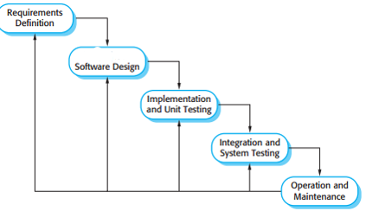

Slide 45
Iterative Model
Cyclic manner repeating every step after every cycle of SDLC process.
The software is first developed on very small scale and then, on every next iteration, more features and modules are designed, coded, tested and added to the software.
Every cycle produces software, which is complete in by itself and has more features and capabilities than that of the previous one
Easier to manage the development process but it consumes more resources.

Slide 46
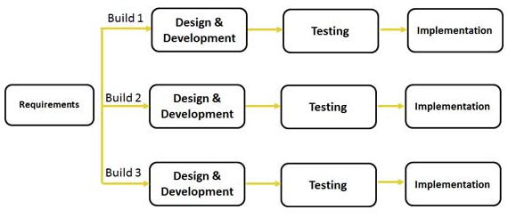

Slide 47
Prototyping Model
Prototype: Implementation of system having limited functional capabilities, low reliability, and inefficient performance compared to the actual software.
Stepwise approach to design a software prototype
Basic Requirement Identification
Developing the initial Prototype
Review of the Prototype
Revise and enhance the Prototype

Slide 48
Spiral Model
It like a spiral with many loops
Has four phases and the software project repeatedly passes through these phases in iterations called Spirals
Each loop of the spiral represents a phase of the software process
Each phase in this model are (the four sectors / quadrants)
First quadrant (Identification/ Objective Setting)
Second Quadrant (Design)
Third Quadrant (Construct or Build)
Fourth Quadrant (Evaluation and Risk Analysis)

Slide 49
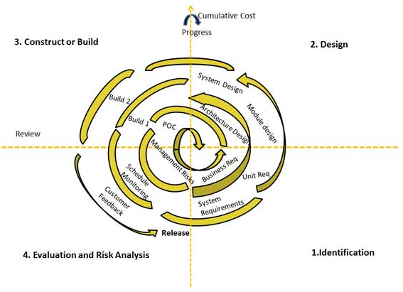

Slide 50
Identification- Phase One
starts with gathering the business requirements in the baseline spiral. In the subsequent spirals as the product matures, identification of system requirements, subsystem requirements and unit requirements are all done in this phase.
This also includes understanding the system requirements by continuous communication between the customer and the system analyst.
Design – Phase Two
Design phase starts with the conceptual design in the baseline spiral and involves architectural design, logical design of modules, physical product design and final design in the subsequent spirals.

Slide 51
Construct or Build- Phase Three
Production of the actual software product at every spiral. In the baseline spiral when the product is just thought of and the design is being developed a POC (Proof of Concept).
Then in the subsequent spirals with higher clarity on requirements and design details a working model of the software called build is produced with a version number.
These builds are sent to customer for feedback.
Evaluation and Risk Analysis- Phase Four
Risk Analysis includes identifying, estimating, and monitoring technical feasibility and management risks, such as schedule slippage and cost overrun.
After testing the build, at the end of first iteration, the customer evaluates the software and provides feedback.

